Slide 1
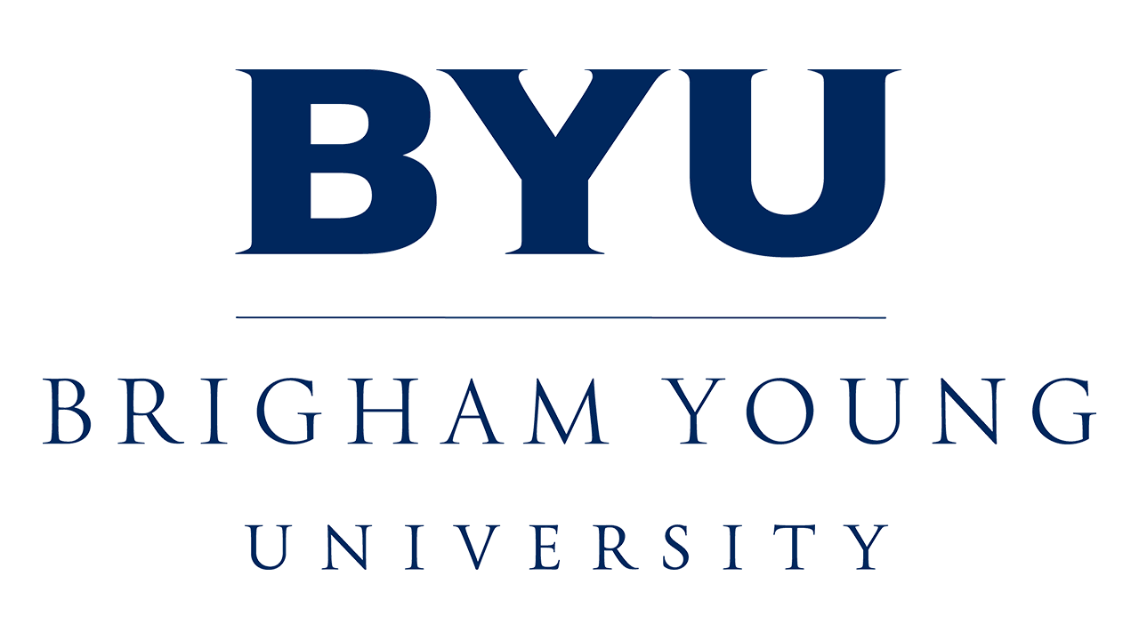
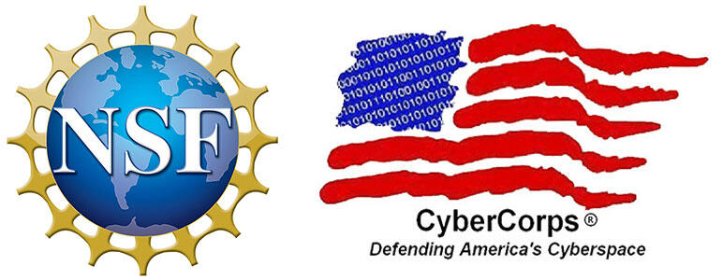
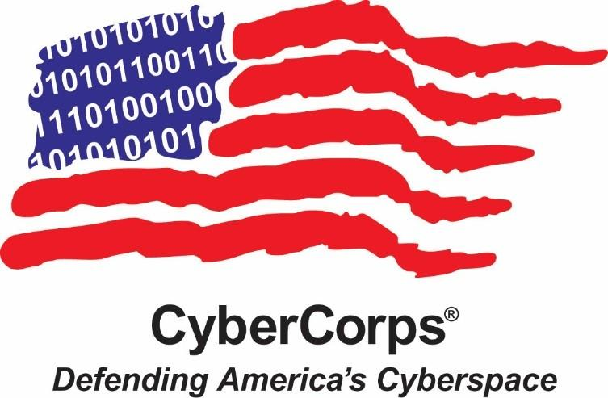
M.S. THESIS DEFENSE
Toward Passwordless
Document Encryption
Isaac Henry Teuscher
Committee: Dr. Ben Schooley (Chair) · Dr. Derek Hansen · Dr. Albert Tay
Department of Electrical & Computer Engineering · Brigham Young University · June 8, 2026

Slide 2
Overview
1
Problem
Sensitive documents, MFT breaches at scale, and why current protection fails.
Ch. 1-2
2
Background
Encryption & passwordless authentication building blocks. Framework and evaluation showing no current method provides all benefits.
Ch. 2-4
3
Design
Novel system: age + WebAuthn PRF together in a working prototype
Ch. 5
4
Study
Counterbalanced within-subjects evaluation of the new system against Adobe Acrobat (N = 21).
Ch. 6
5
Results
Usability, acceptance, and adoption findings. Takeaways and future research.
Ch. 7-8

Slide 3
Research questions
R1
R2
R3
Current Limitations
Novel Design
Usability + User Acceptance
What are the security, usability, and deployability limitations of current document encryption methods?
How can open-source tools be used to design a passwordless, non-proprietary, per-file document protection system?
What is the usability and user acceptance of a passwordless document encryption system?
Notes:
Entering question: What does this thesis ask? Key point: Passkeys might help — but how do current methods actually compare?

Slide 4
1
SECTION 1 / 5
Problem
Sensitive documents, MFT breaches at scale, and why current protection fails.
1 Problem
2 Background
3 Design
4 Study
5 Results

Slide 5
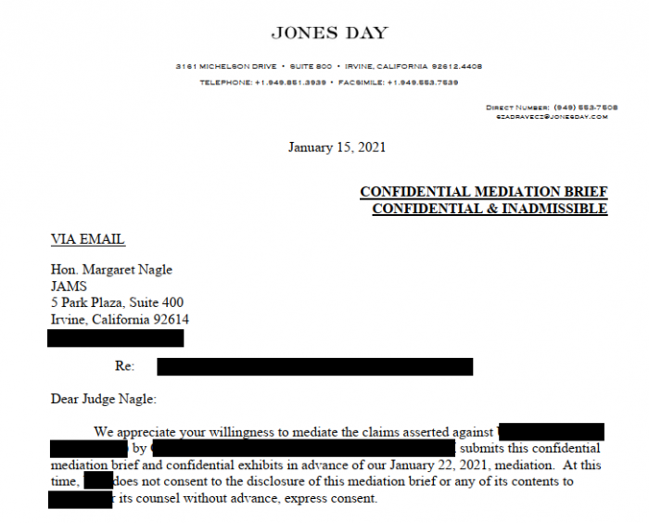
Sensitive documents are everywhere
Finance, legal, healthcare, government.
Confidential files are created everyday and must be shared with external users outside any single organization's control.
Example: confidential legal brief
1 Problem
2 Background
3 Design
4 Study
5 Results
Notes:
Entering question: What is this thesis about? Key point: Protecting confidentiality in transit and at rest is the core problem.

Slide 6
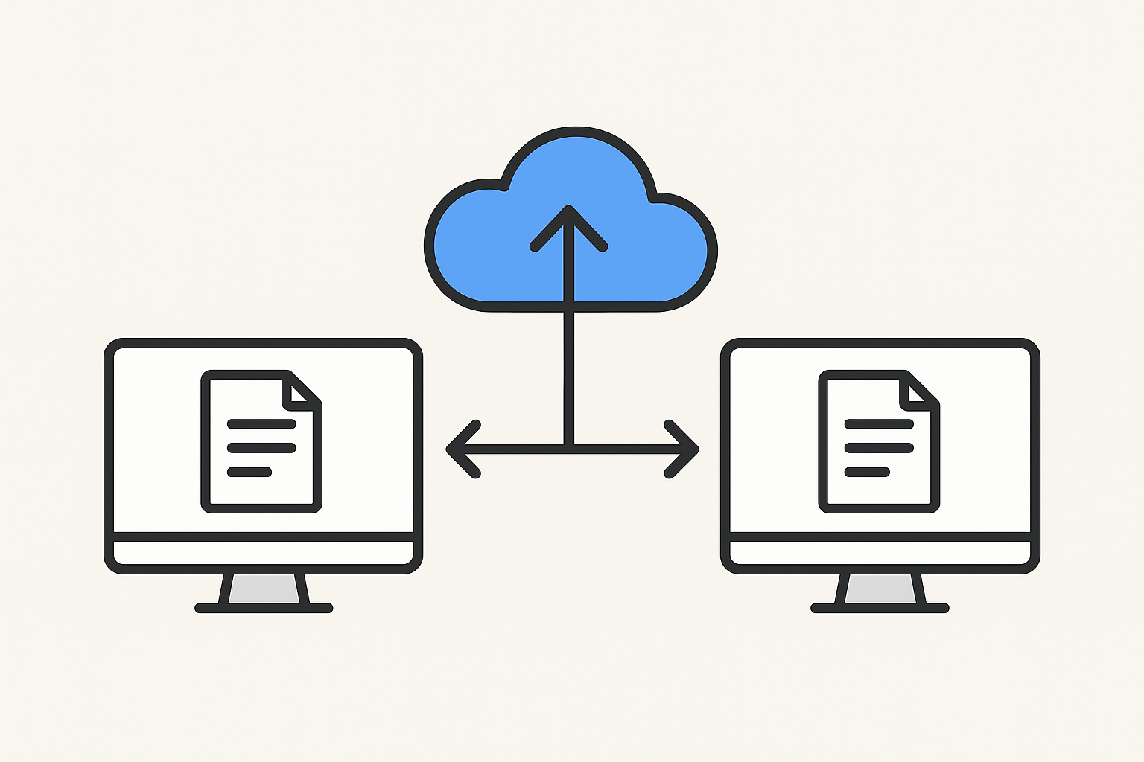



Lawyer
Judge

Slide 7
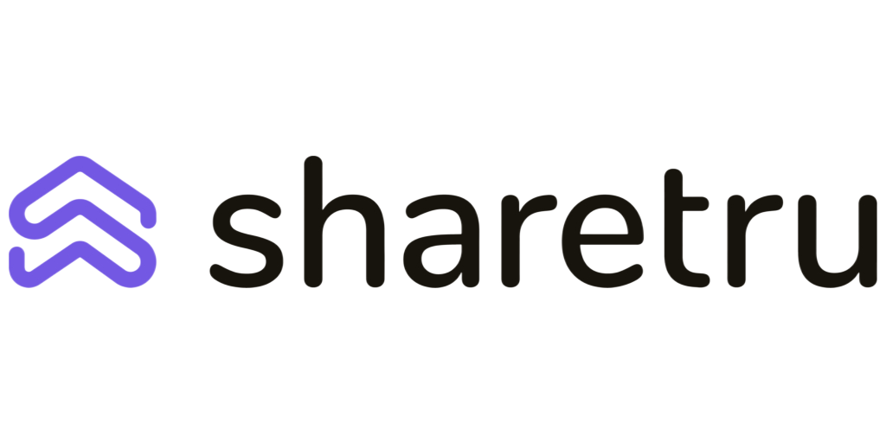
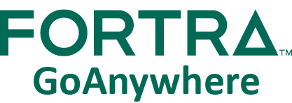

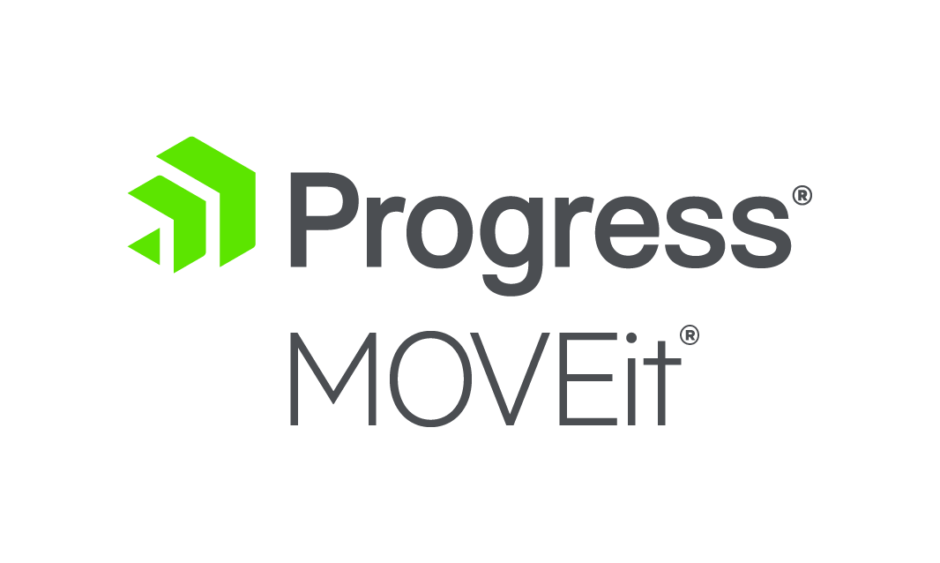
MFT
Lawyer
Judge

Slide 8

MFT
Lawyer
Judge

Slide 9
MFT
Lawyer
Judge

Slide 10
MFT
Lawyer
Judge

Slide 11
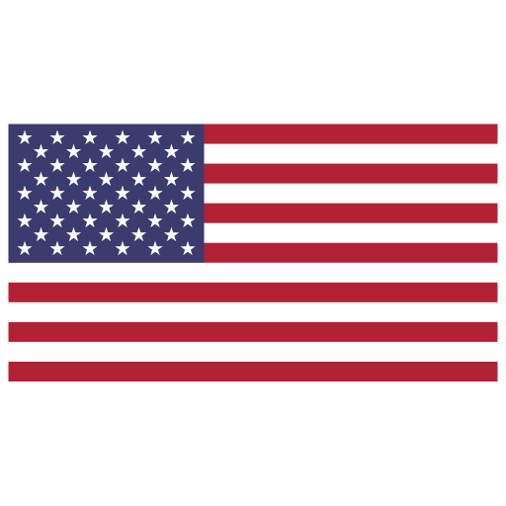
This is not hypothetical.
May 2023 MOVEit breach
Hacked by CL0P
x 95,788,491
people
28% of
1 Problem
2 Background
3 Design
4 Study
5 Results
Notes:
Entering question: How bad is the problem really? Key point: This is not a one-off — it is a recurring, large-scale failure mode.

Slide 12
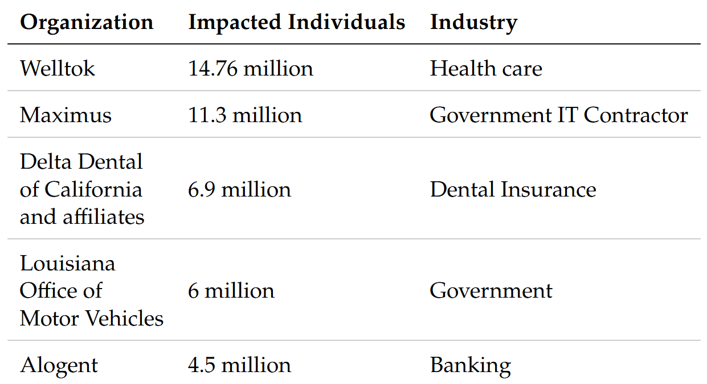
1 Problem
2 Background
3 Design
4 Study
5 Results
Notes:
Entering question: How bad is the problem really? Key point: This is not a one-off — it is a recurring, large-scale failure mode.

Slide 13
A systematic pattern of Managed File Transfer (MFT) breaches:
Accellion
Dec 2020
Serv-U
Nov 2021
GoAnywhere
Jan 2023
MOVEit
May 2023
Cleo
Dec 2024
Wing FTP
Jul 2025
1 Problem
2 Background
3 Design
4 Study
5 Results
Notes:
Entering question: How bad is the problem really? Key point: This is not a one-off — it is a recurring, large-scale failure mode.

Slide 14
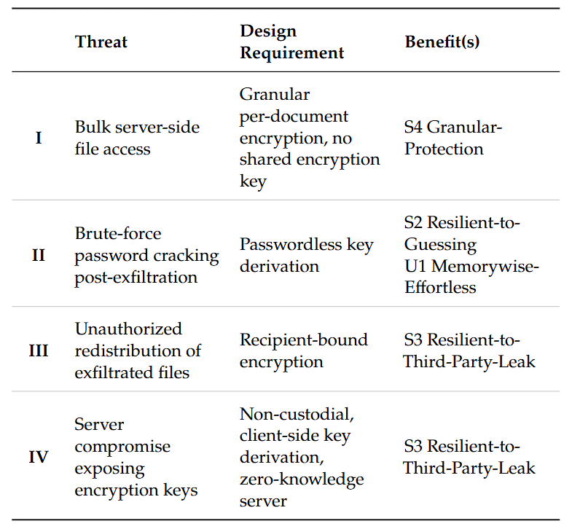
Adversary Threat Model
1 Problem
2 Background
3 Design
4 Study
5 Results
Notes:
Entering question: How bad is the problem really? Key point: This is not a one-off — it is a recurring, large-scale failure mode.

Slide 15
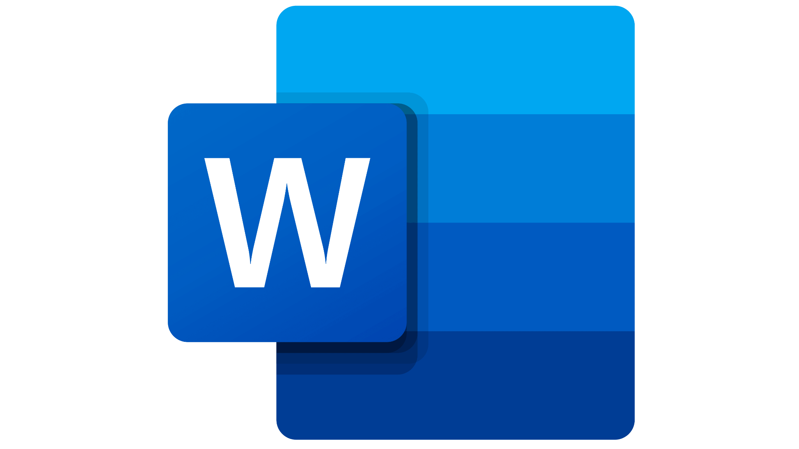
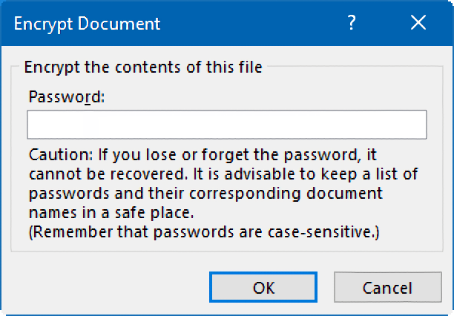
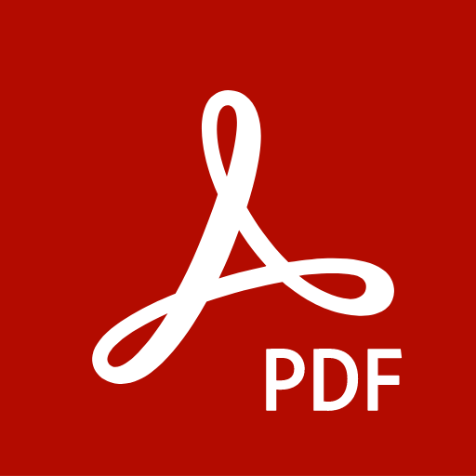
Usability…
1 Problem
2 Background
3 Design
4 Study
5 Results
Notes:
Entering question: How bad is the problem really? Key point: This is not a one-off — it is a recurring, large-scale failure mode.

Slide 16


Two things are broken
Perimeter & at-rest only
Password-based encryption
MFT and cloud storage encrypt files only “at rest.” Once an attacker is inside the system, every file can be read.
Word / Acrobat passwords are vulnerable to brute force, can’t be recovered if lost, and the password must somehow be shared securely.
One breach → all documents exposed
Stuck on 1990s technology
1 Problem
2 Background
3 Design
4 Study
5 Results
Notes:
Entering question: Why hasn't document protection kept up? Key point: Protection leans on perimeter defense and user-chosen passwords.

Slide 17
2
SECTION 2 / 5
Background
Encryption and passwordless authentication building blocks and a framework and evaluation showing no current method provides all benefits.
1 Problem
2 Background
3 Design
4 Study
5 Results

Slide 18
A framework of 15 benefits
Usability (5)
Deployability (6)
Security (4)
Memorywise-effortless
Scalable for users
Easy to learn
Easy recovery from loss
Seamless sharing
Negligible cost per user
Negligible IT support cost
Compatible
Mature
Non-proprietary
Guest-friendly
Resilient to observation
Resilient to guessing
Resilient to third-party leak
Recipient-bound
1 Problem
2 Background
3 Design
4 Study
5 Results
Notes:
Entering question: The evaluation lens Key point: 15 requirements an ideal document-protection method should satisfy.

Slide 19
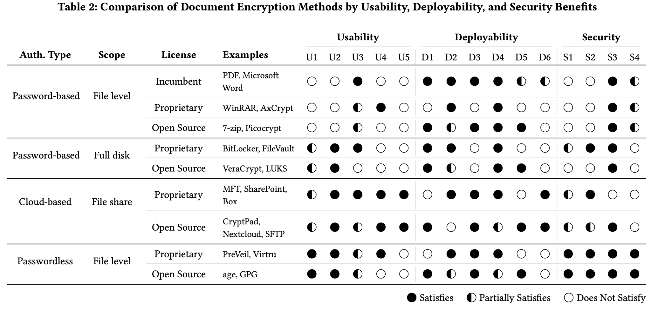
No existing method does it all
1 Problem
2 Background
3 Design
4 Study
5 Results
Notes:
Entering question: What the framework shows Key point: Passwordless is strongest on security — can we fix its deployability & sharing gaps?

Slide 20
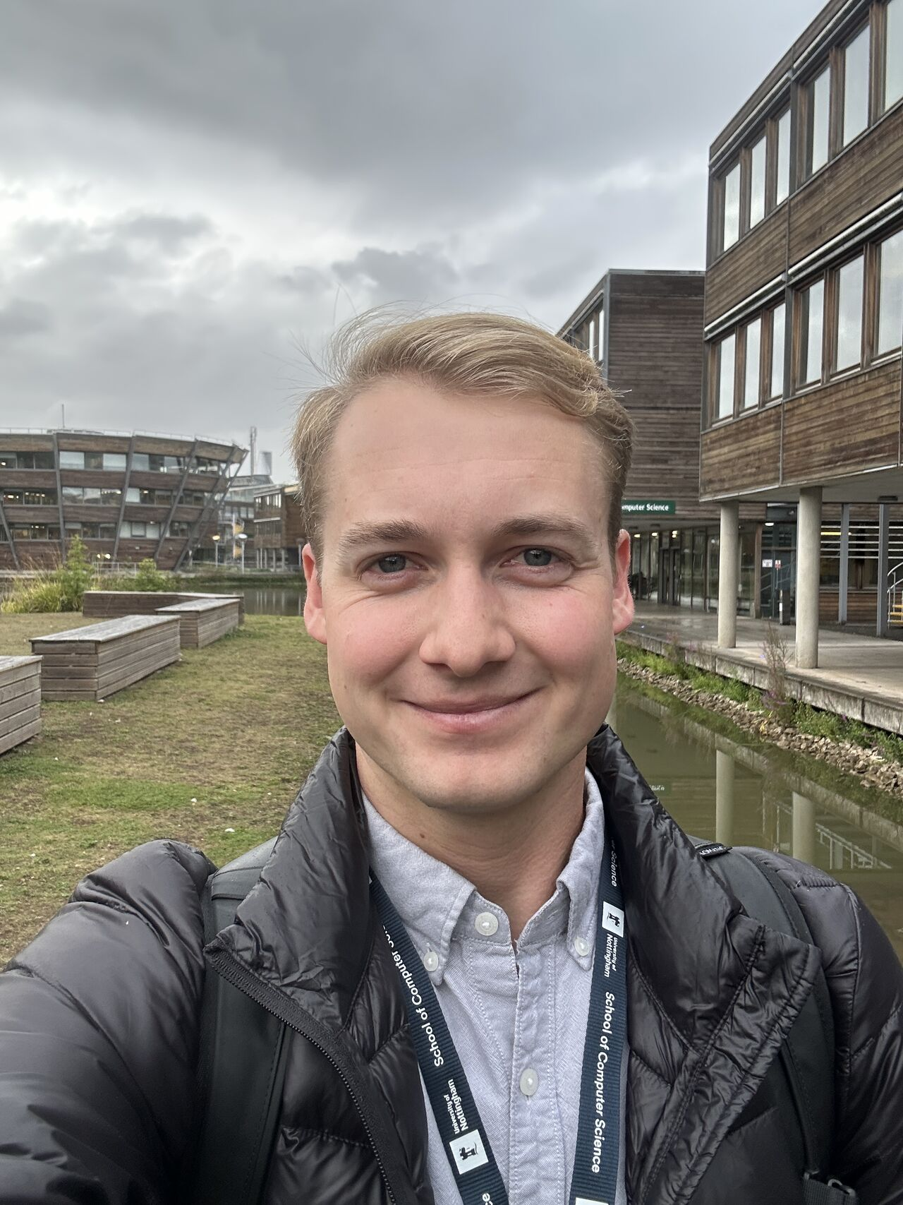

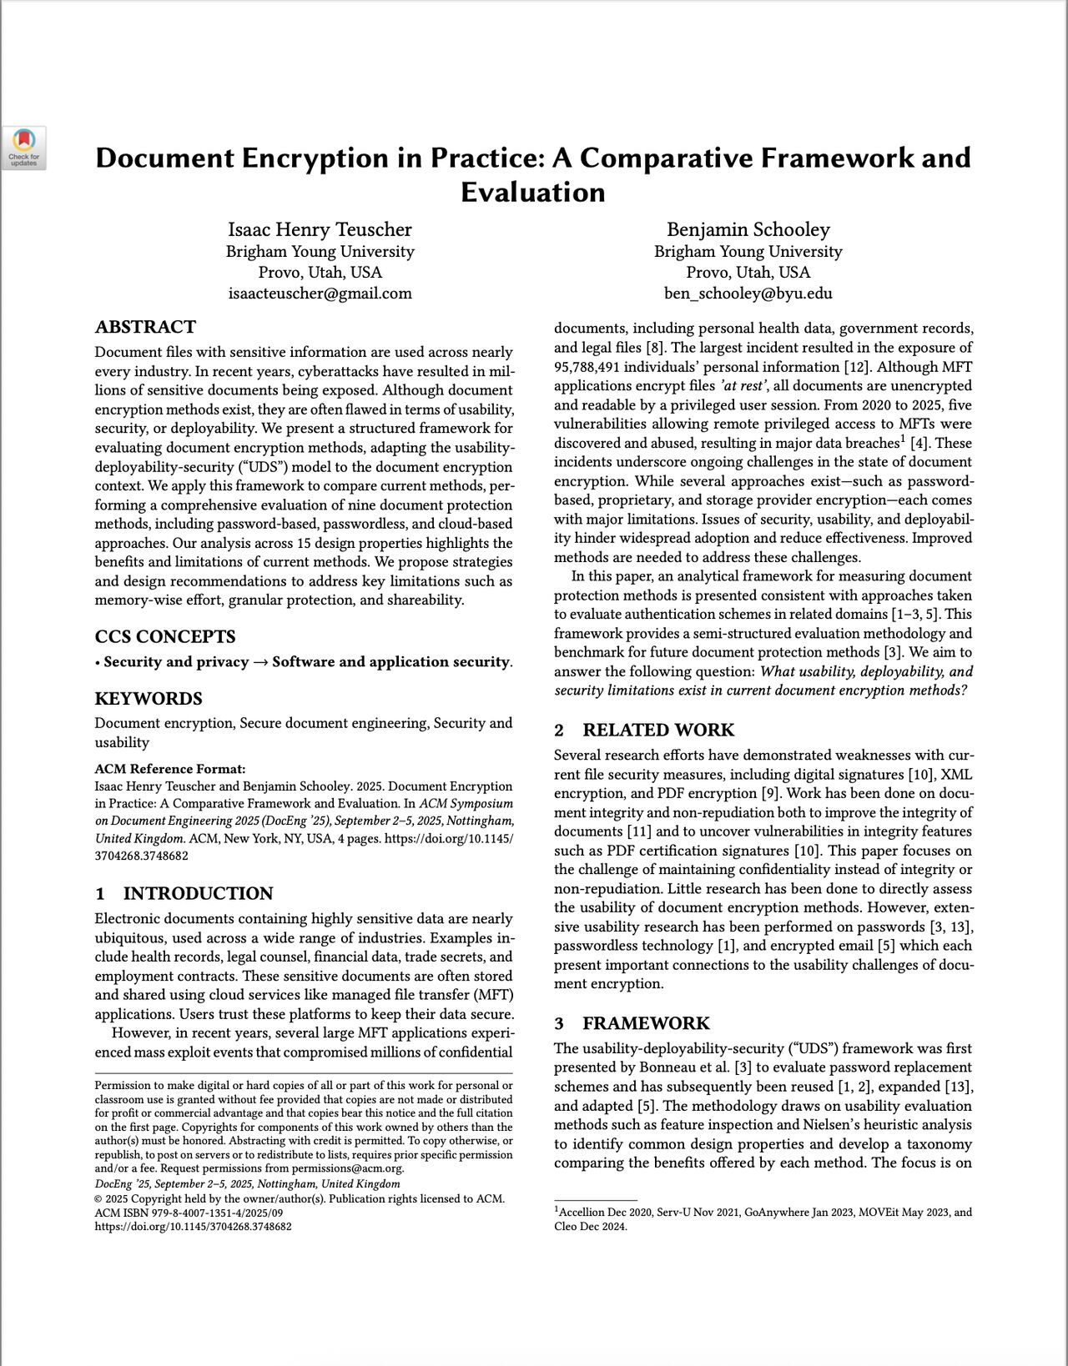
Sept 2025, Doc Eng Nottingham, UK

Slide 21

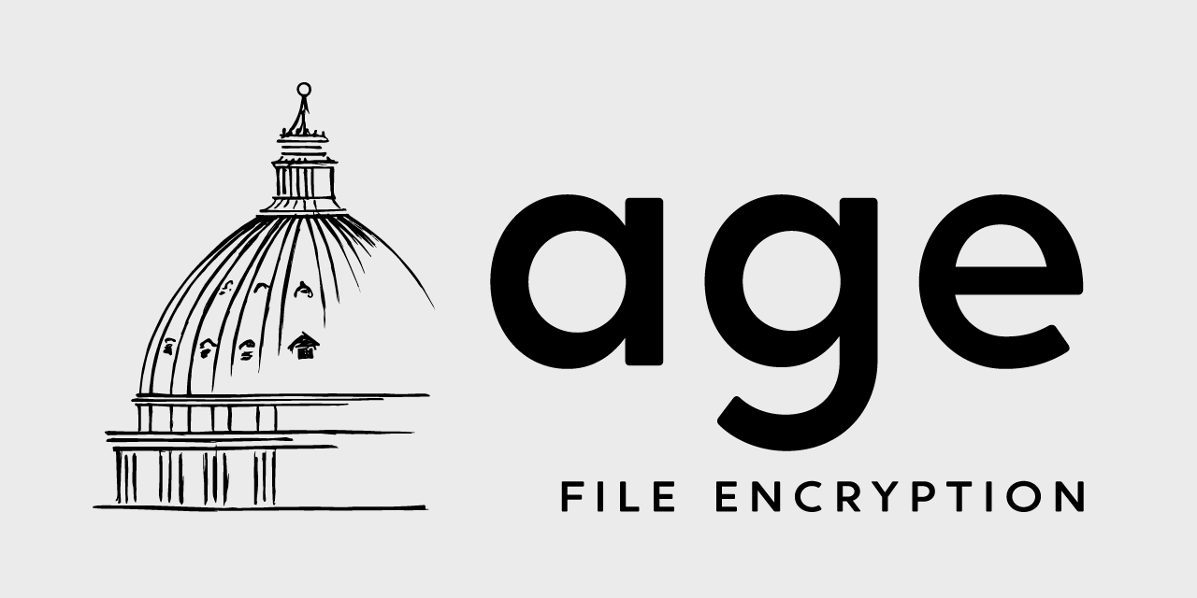
Building block 1: age encryption
Per-file keys — A unique 128-bit key wraps each individual file, not one shared secret.
Multi-recipient — A file can be encrypted to several recipients, each decrypting independently.
Post-quantum ready — Native hybrid ML-KEM-768 recipients (age 1.3.0) for cryptographic agility.
age: open-source file encryption
Open-source — Simple format, no licensing fees. Satisfies the non-proprietary requirement.
1 Problem
2 Background
3 Design
4 Study
5 Results
Notes:
Entering question: Are there good encryption building blocks? Key point: Encryption is solved — but how do you authenticate without a password?

Slide 22
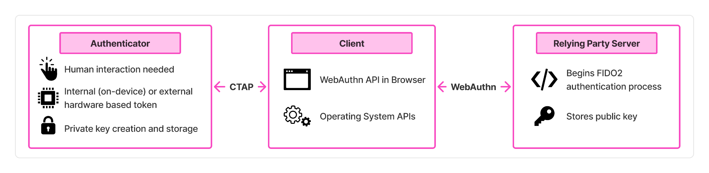
Building block 2: FIDO2 (passkeys) + WebAuthn
1 Problem
2 Background
3 Design
4 Study
5 Results
Notes:
Entering question: How do you authenticate without a password? Key point: Passkeys are close to ideal for authentication — can they reach into encryption?

Slide 23
FIDO2 (passkeys) have reached widespread adoption
Backed by Google, Microsoft, and Apple. Now supported across browsers, operating systems, and major websites.
5 billion
90%
75%
68%
active passkeys in use globally
of consumers are familiar with passkeys
have enabled passkeys on some accounts
of organizations deploying or piloting passkeys
Source: FIDO Alliance, State of Passkeys 2026 — survey of 11,000 consumers across ten countries.
1 Problem
2 Background
3 Design
4 Study
5 Results
Notes:
FIDO Alliance State of Passkeys 2026 (n=11,000 across 10 countries): ~5B active passkeys, 90% familiar, 75% enabled on some accounts, 68% of orgs deploying/piloting. Cite [7]. Point: deployability — historically the barrier to password replacement — is now largely solved for FIDO2, which is what makes building on it realistic.

Slide 24
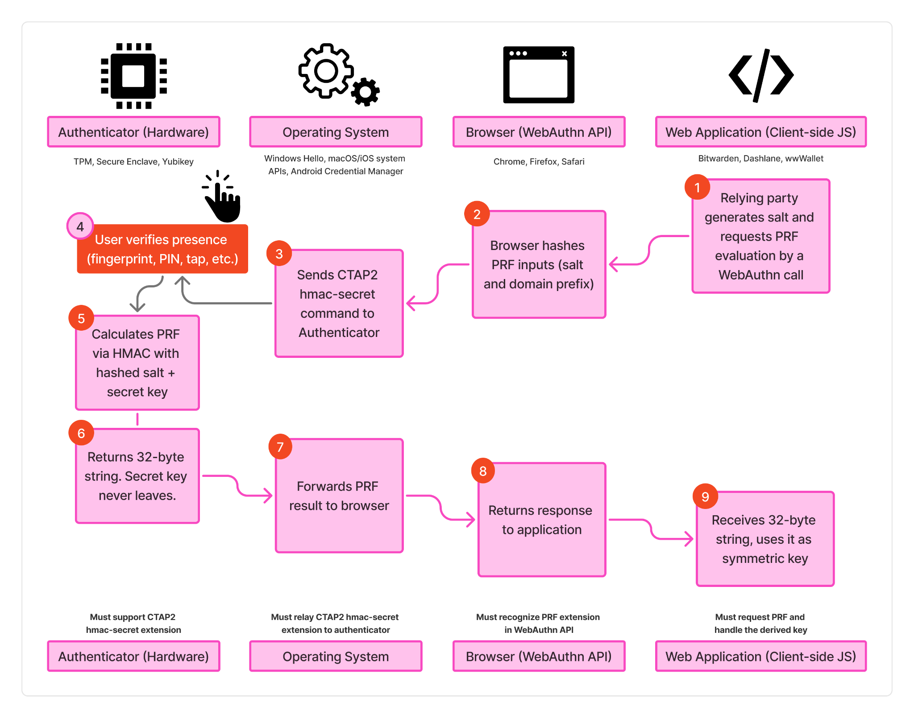
Building block 3: WebAuthn PRF
From login to keys
The PRF extension lets a passkey output a 32-byte secret derived inside the authenticator. The secret key never leaves the device. The app uses the output directly as a symmetric encryption key.
1 Problem
2 Background
3 Design
4 Study
5 Results
Notes:
Entering question: The key idea Key point: PRF turns a passkey into a source of encryption keys.

Slide 25
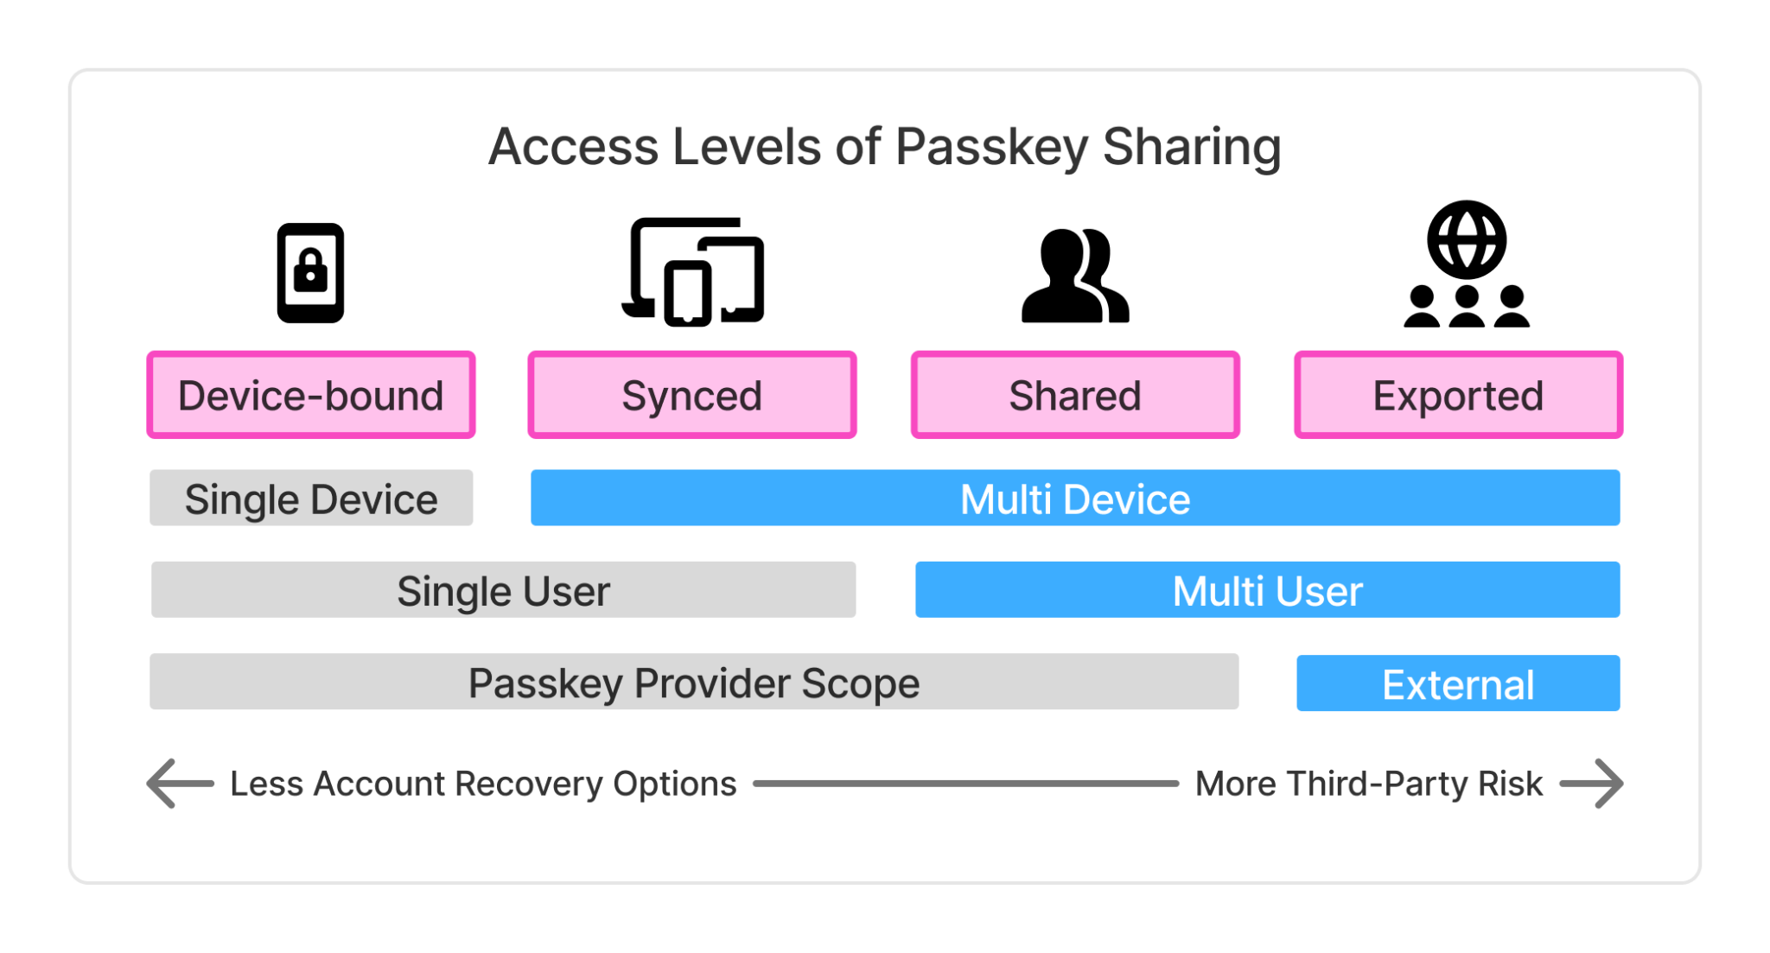
1 Problem
2 Background
3 Design
4 Study
5 Results
Notes:
Entering question: How do you authenticate without a password? Key point: Passkeys are close to ideal for authentication — can they reach into encryption?

Slide 26
3
SECTION 3 / 5
Design
A novel system bringing age and WebAuthn PRF together in a working prototype.
1 Problem
2 Background
3 Design
4 Study
5 Results

Slide 27



Three phases of design-based research
1. Framework Analysis
›
2. System Design
›
3. User Study
Build a comparative framework and systematically evaluate existing document encryption methods.
Derive design requirements and iteratively build a prototype.
Run a controlled, within-subjects study comparing the new system against password-based encryption.
Chapter 4
Chapter 5
Chapters 6 & 7
1 Problem
1 Problem
2 Background
2 Background
4 Study
4 Study
5 Results
3 Design
5 Results
Notes:
Entering question: How was this research conducted? Key point: Phase 1 first: what does the framework reveal about today's methods?

Slide 28

Designed & implemented system
age
FIDO2 passkeys
WebAuthn PRF
+
+
+
per-file, multi-recipient, open-source, PQ-ready encryption
fairly familiar, non-custodial, phishing-resistant identity
derives symmetric key from passkey, for end-to-end encryption per file
▼
Passwordless Document Encryption
Non-custodial, passwordless, per-file end-to-end document encryption, entirely in the browser. The server only holds ciphertext and public keys; encryption and keys never leave the client.
1 Problem
2 Background
3 Design
4 Study
5 Results
Notes:
Entering question: Can we build something that fills the gaps? Key point: No passwords, no shared secrets, no plaintext on the server.

Slide 29
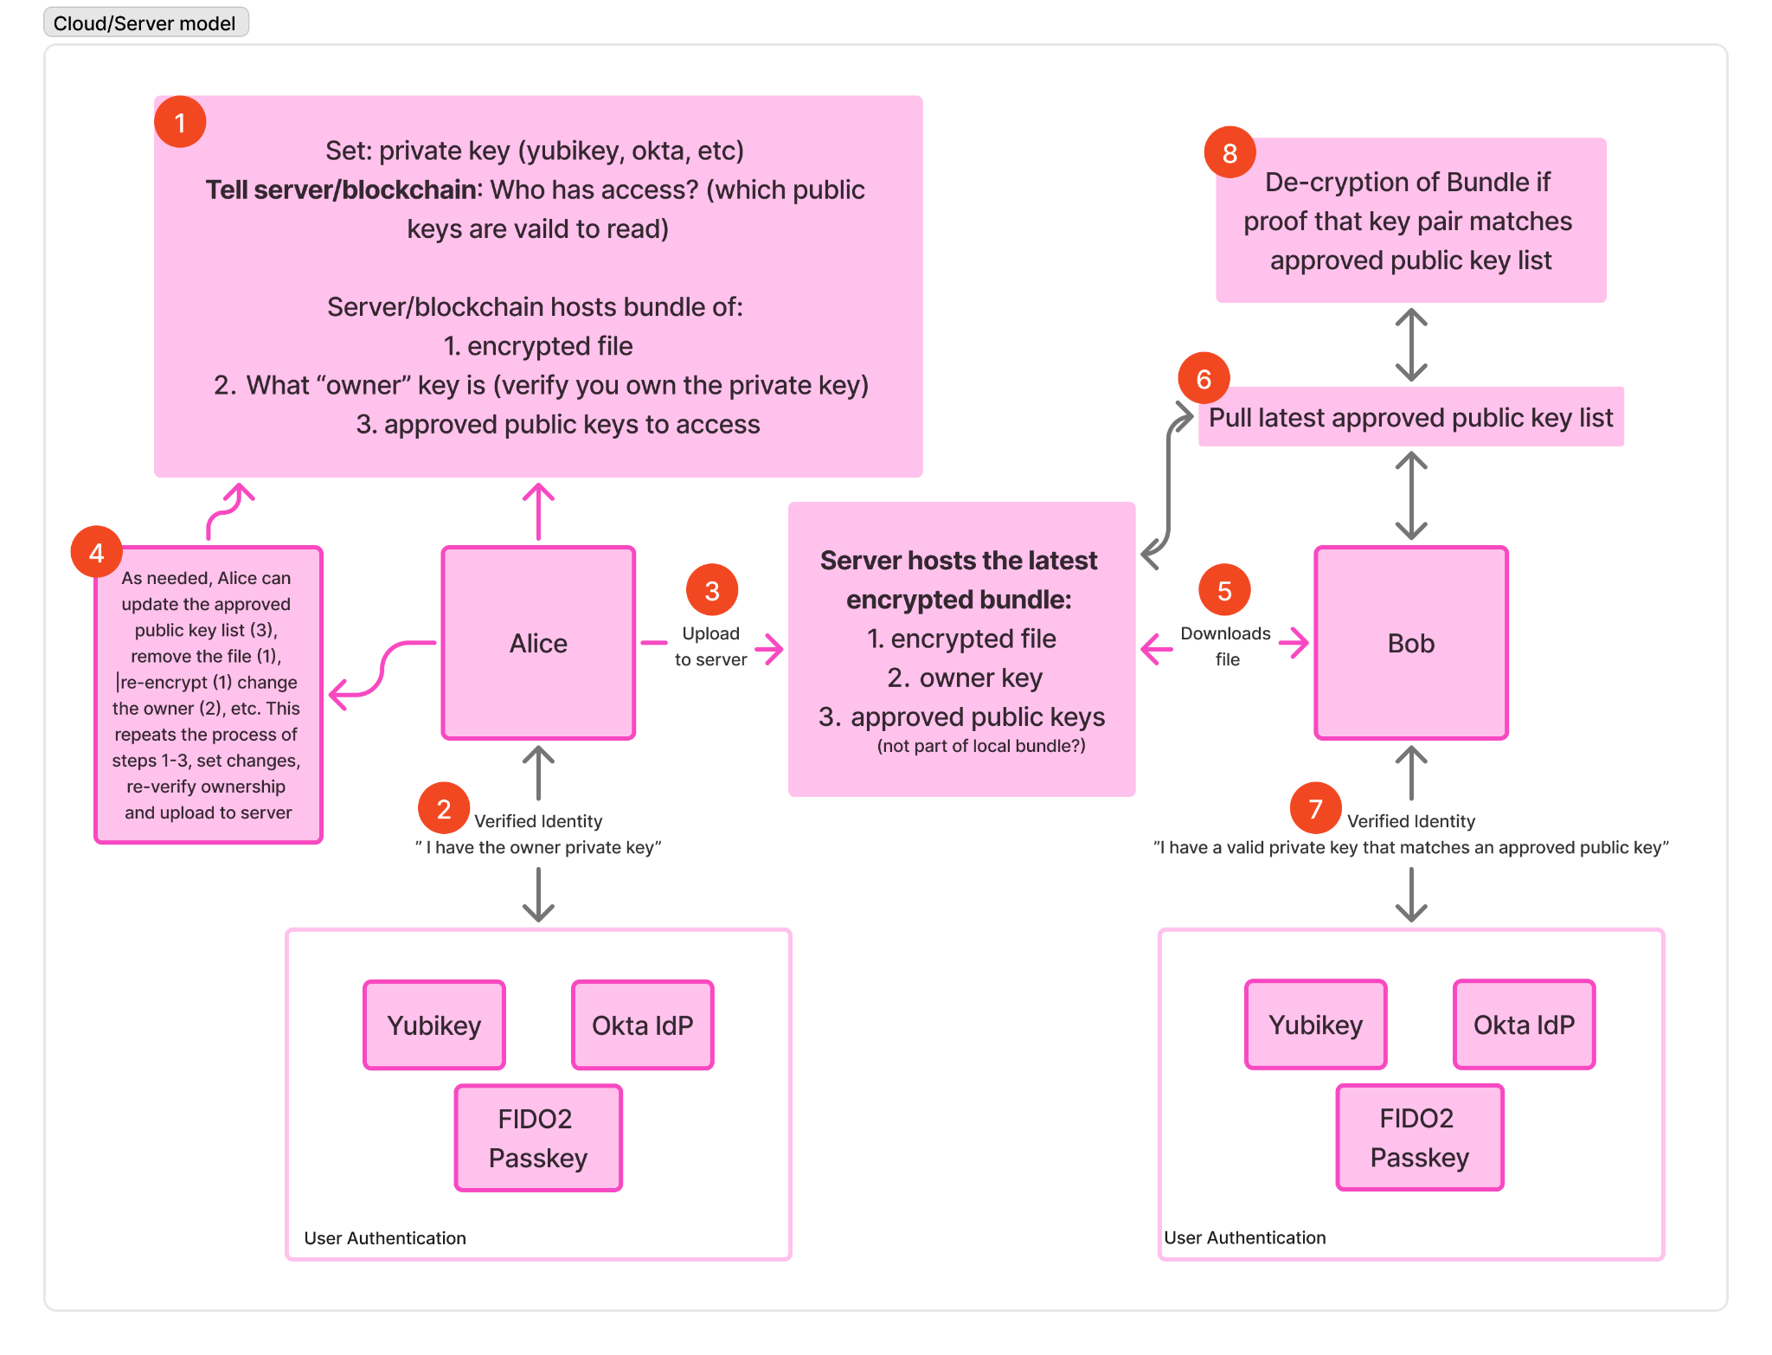
1 Problem
2 Background
3 Design
4 Study
5 Results
Notes:
Entering question: How it works — 2 of 2 Key point: Owner can revoke or re-share — yet the server can never decrypt the file.

Slide 30
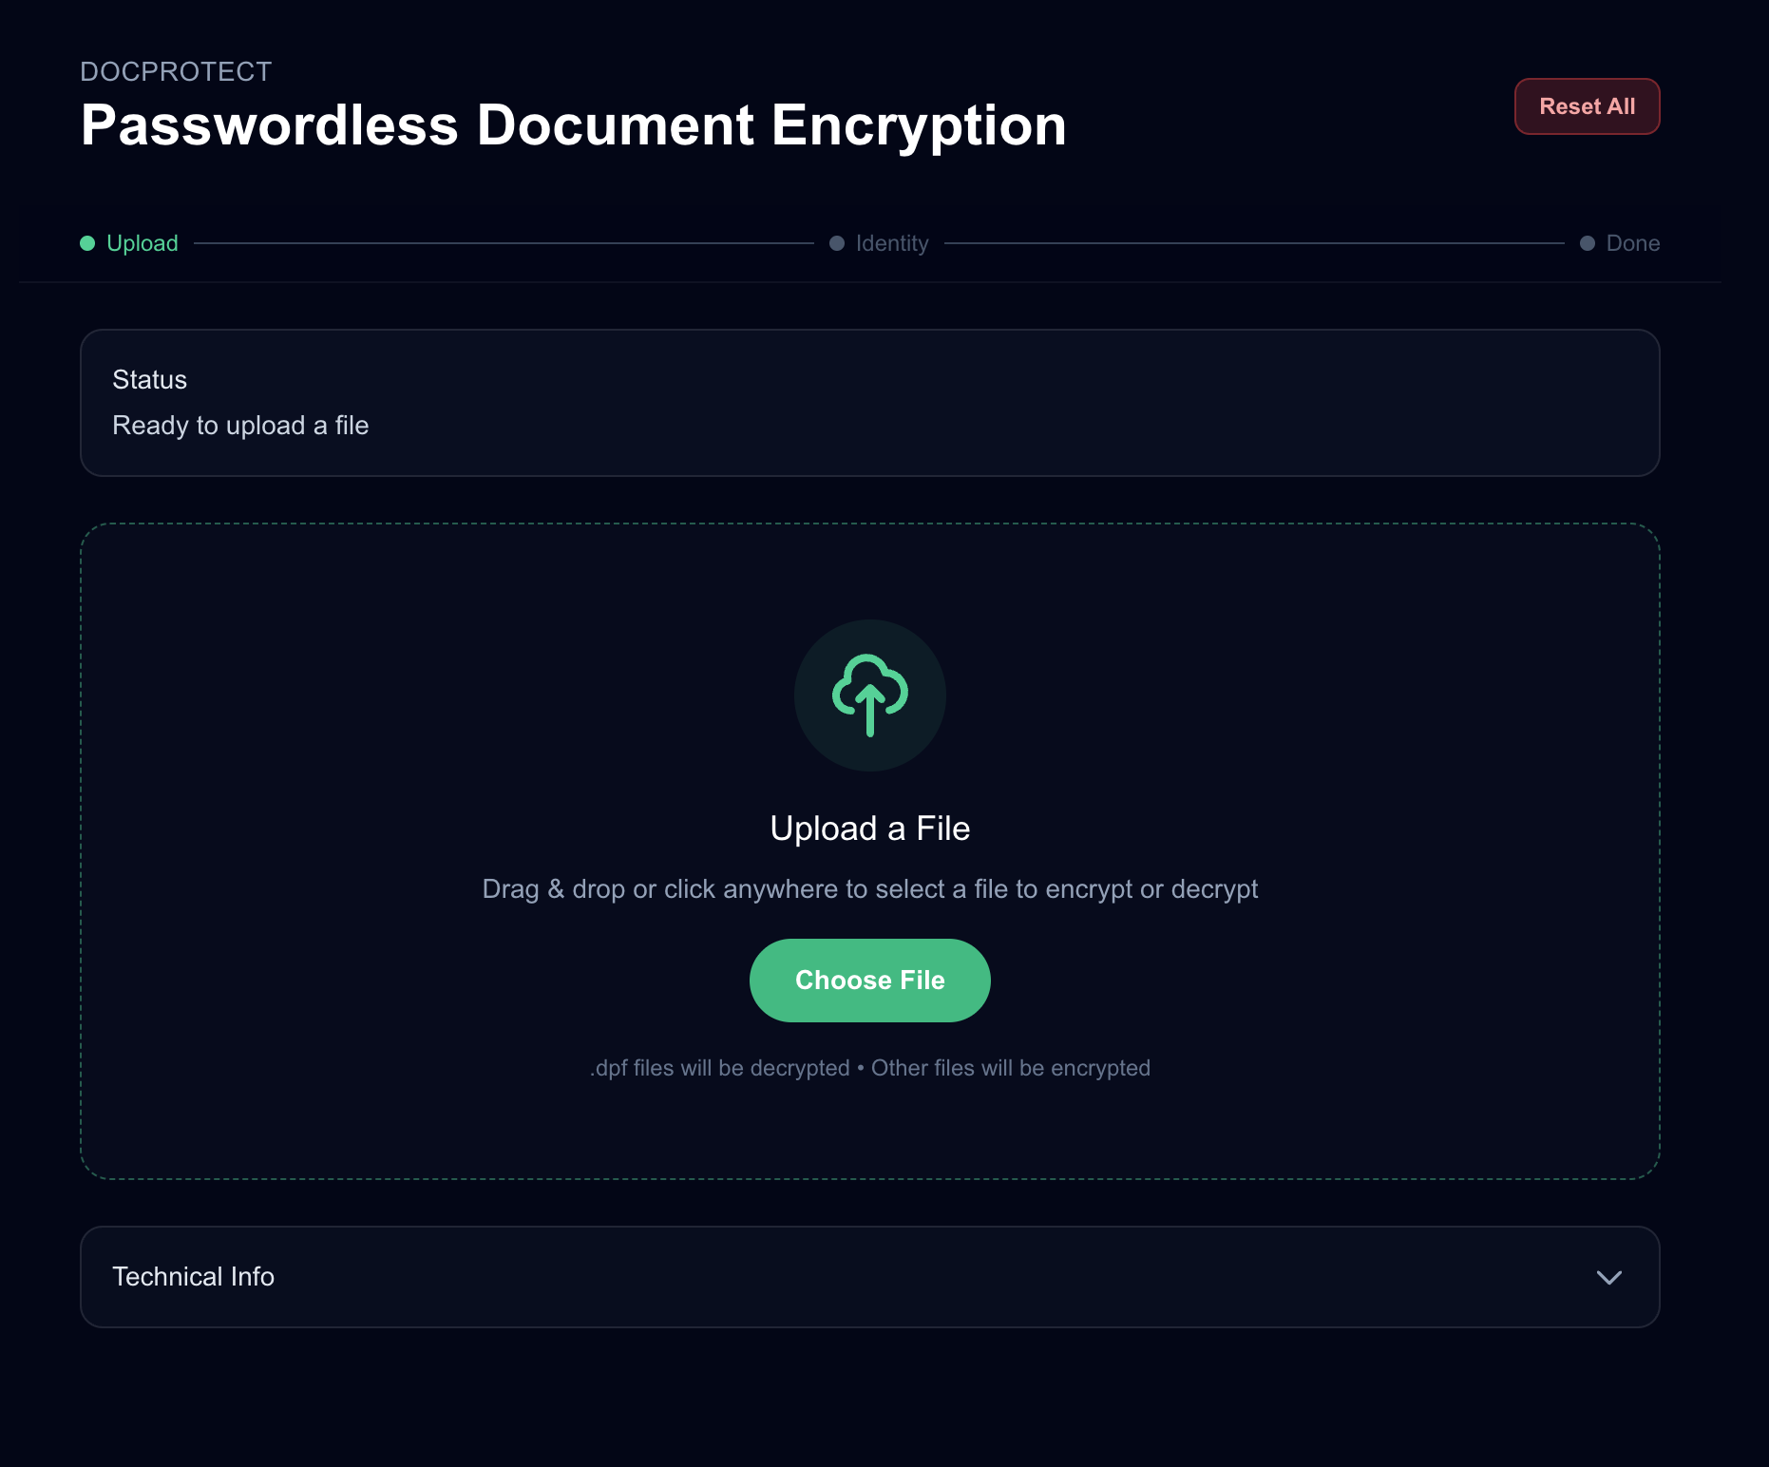
Functional prototype system
1
Upload any file: Encrypt or decrypt from a single browser interface. Nothing to install.
2
Create or use a passkey: Identity is verified with a fingerprint, face scan, or security key.
3
Add recipients by email: age multi-recipient encryption, bound to each recipient's passkey.
4
Share a link or download: file downloads for offline-sharing, creates realistic link imitates future features.
1 Problem
2 Background
3 Design
4 Study
5 Results
Notes:
Entering question: The proof of concept Key point: Open source — iteuscher/doc-protect · doc-protect.vercel.app

Slide 31
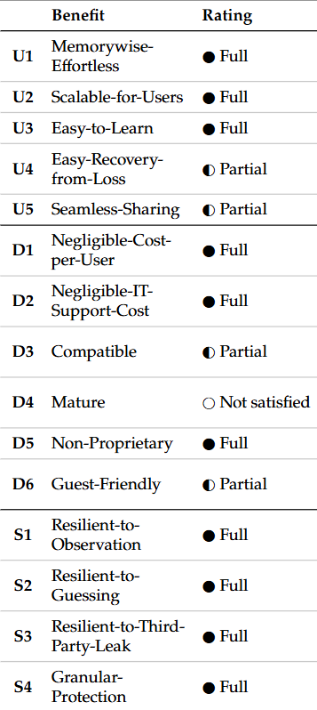
Implemented system evaluation
1 Problem
2 Background
3 Design
4 Study
5 Results
Notes:
Entering question: How it works — 2 of 2 Key point: Owner can revoke or re-share — yet the server can never decrypt the file.

Slide 32
4
SECTION 4 / 5
Study
Counterbalanced within-subjects evaluation of the new system against Adobe Acrobat (N = 21).
1 Problem
2 Background
3 Design
4 Study
5 Results

Slide 33
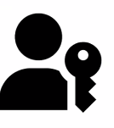
Within-subjects user study
N = 21
Within-subjects
IRB-approved
Mixed methods
participants, each used both systems
counterbalanced order (Passwordless ↔ Adobe Acrobat)
Exempt as low-risk study
validated scales + semi-structured interviews
vs.
1 Problem
2 Background
3 Design
4 Study
5 Results
Notes:
Entering question: Will users actually find it usable? Key point: A fair, first-use comparison against a mature commercial tool.

Slide 34
Instruments
SUS
System Usability Scale: single 0–100 usability score, benchmarked
VdL
Van der Laan: usefulness & satisfaction acceptance subscales
ATI
Affinity for Technology Interaction: possible covariate
PC
Privacy Concern scale: possible covariate
Q+A
10 interview questions, thematic analysis
1 Problem
2 Background
3 Design
4 Study
5 Results
Notes:
Entering question: What did we measure? Key point: Quantitative comparison plus qualitative depth.

Slide 35
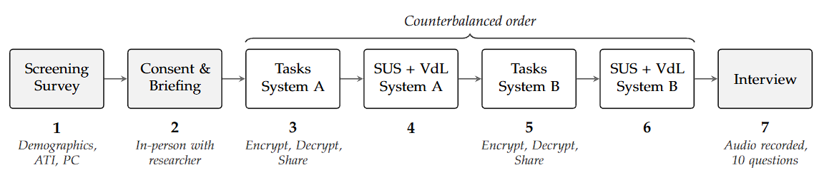
Within-subjects user study
vs.
1 Problem
2 Background
3 Design
4 Study
5 Results
Notes:
Entering question: Will users actually find it usable? Key point: A fair, first-use comparison against a mature commercial tool.

Slide 36
Participants (N = 21)
29.2
71%
76%
67%
mean age (SD 11.7)
had a technical background
male · 24% female
held a bachelor's degree
ATI (technology affinity, 1–6): M = 4.11 Privacy Concern (1–7): M = 5.58 Scales nearly all α ≥ .80
1 Problem
2 Background
3 Design
4 Study
5 Results
Notes:
Entering question: Who participated? Key point: A technically literate sample with high baseline privacy concern.

Slide 37
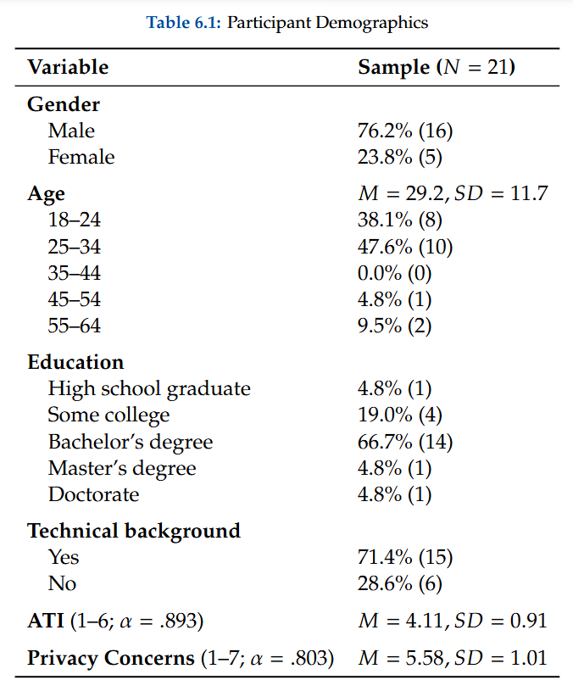
1 Problem
2 Background
3 Design
4 Study
5 Results
Notes:
Entering question: Who participated? Key point: A technically literate sample with high baseline privacy concern.

Slide 38
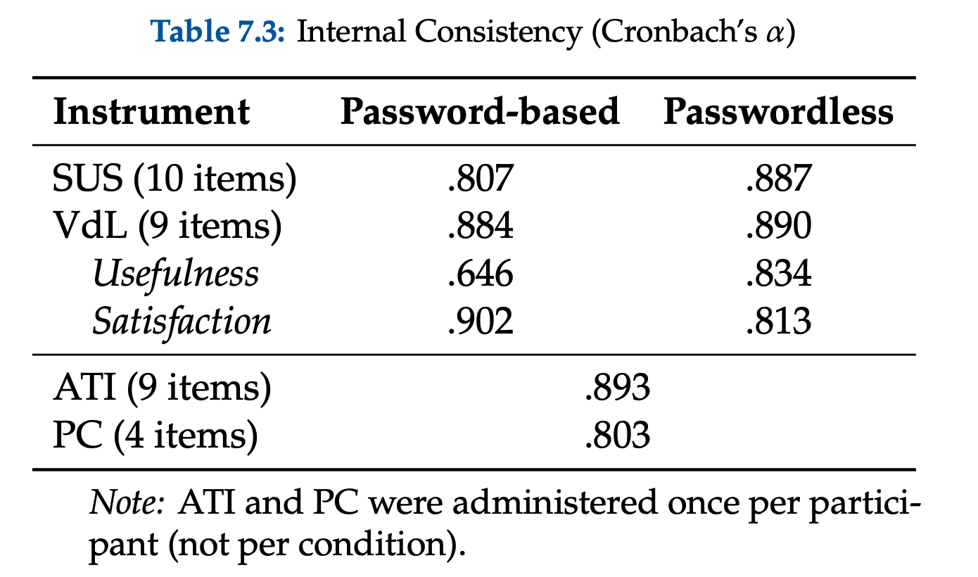
Internal consistency (Cronbach’s alpha)
1 Problem
2 Background
3 Design
4 Study
5 Results
Notes:
Entering question: What did the data show? Key point: First-use friction concentrates among less tech-savvy users — a design target.

Slide 39
5
SECTION 5 / 5
Results
Usability, acceptance, and adoption findings — plus takeaways and future research.
1 Problem
2 Background
3 Design
4 Study
5 Results

Slide 40
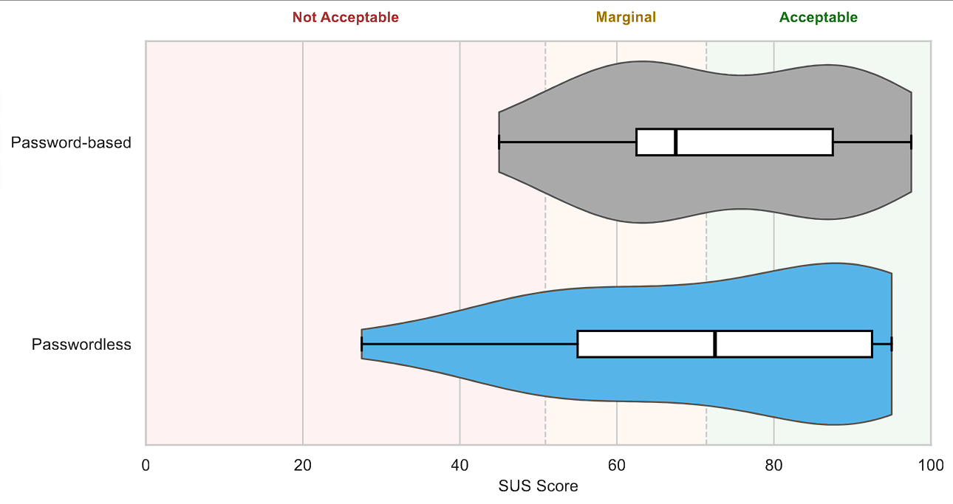
Finding 1: usability parity on first use
SUS scores
73.3 password-based
72.0 passwordless
No significant difference (Wilcoxon W = 113.5, p = .944).
A brand-new passwordless prototype matched a mature commercial tool on first use.
1 Problem
2 Background
3 Design
4 Study
5 Results
Notes:
Entering question: What did the data show? Key point: Parity with Adobe Acrobat — itself a meaningful result for a prototype.

Slide 41
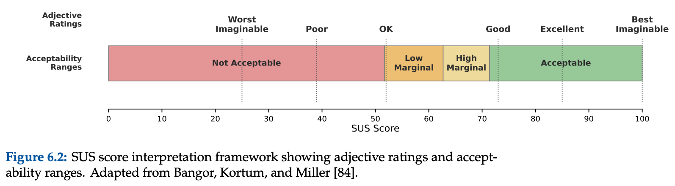
SUS benchmarking
SUS scores
73.3 password-based
72.0 passwordless
1 Problem
2 Background
3 Design
4 Study
5 Results
Notes:
Entering question: What did the data show? Key point: Parity with Adobe Acrobat — itself a meaningful result for a prototype.

Slide 42
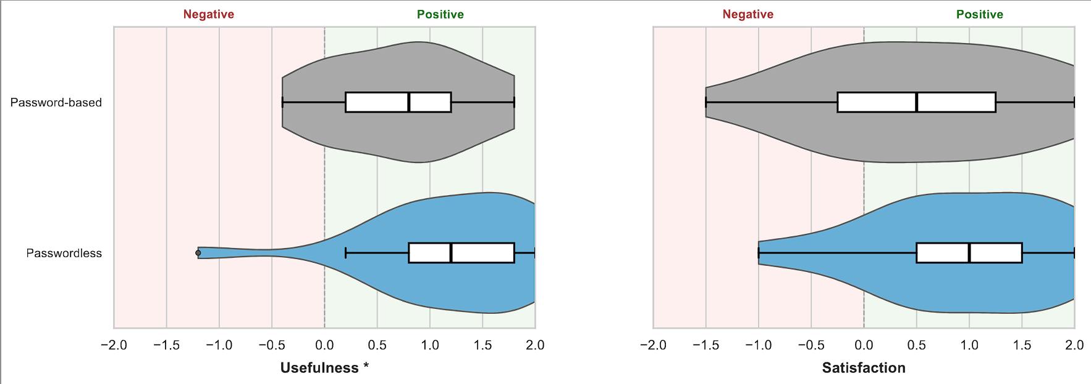
Finding 2: passwordless rated significantly more useful
+0.73 vs +1.19, p = .014 *
+0.52 vs +0.93, p = .078
1 Problem
2 Background
3 Design
4 Study
5 Results
Notes:
Entering question: What did the data show? Key point: Equal to use, but seen as more useful — with a large effect (r = .63).

Slide 43
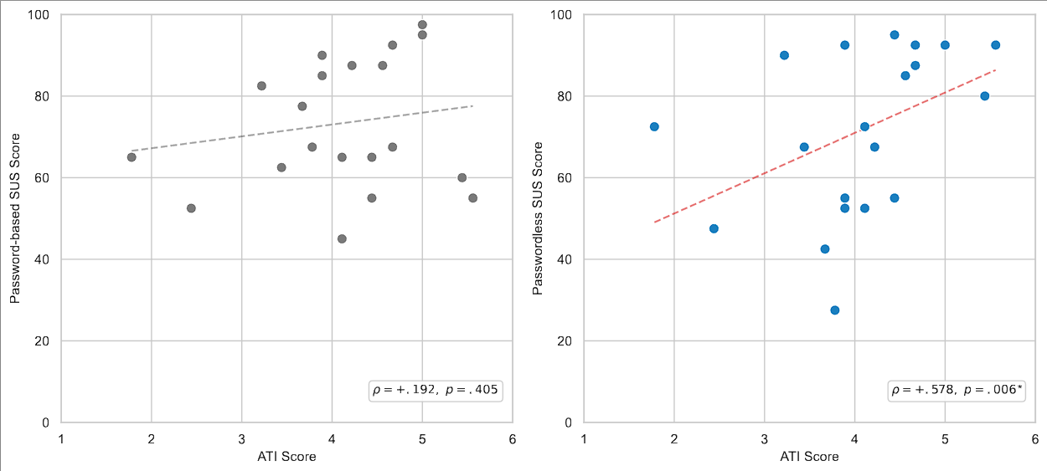
Finding 3: tech affinity predicts perceived usability
ρ = +.578 (p = .006)
Technology affinity (ATI) strongly predicts how usable people find the new passwordless system but does NOT predict ratings of the familiar password-based system.
Echoes Kupris & Schreck’s (IEEE S&P 2026) ATI to usability finding.
1 Problem
2 Background
3 Design
4 Study
5 Results
Notes:
Entering question: What did the data show? Key point: First-use friction concentrates among less tech-savvy users — a design target.

Slide 44
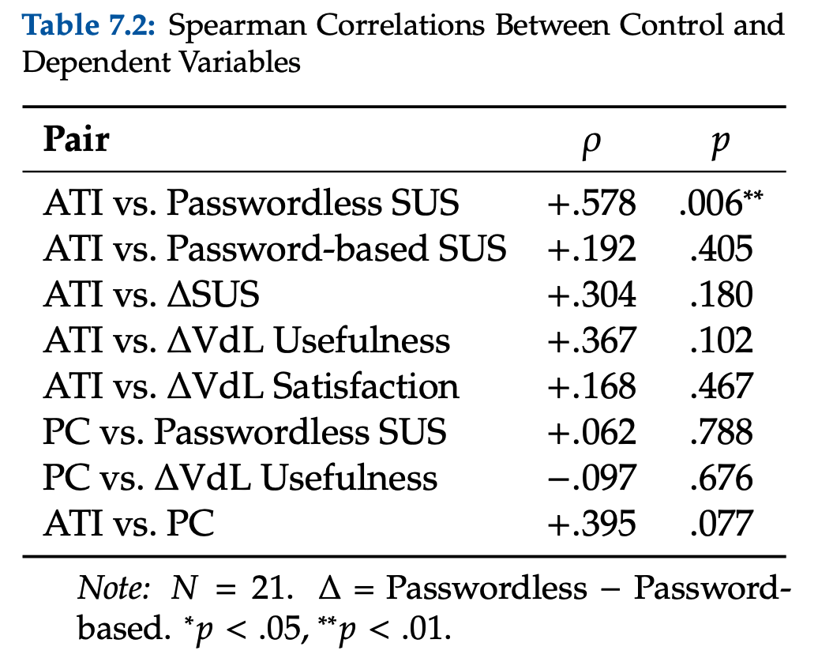
Finding 3: tech affinity predicts perceived usability
1 Problem
2 Background
3 Design
4 Study
5 Results
Notes:
Entering question: What did the data show? Key point: First-use friction concentrates among less tech-savvy users — a design target.

Slide 45
Finding 4: clear preference to adopt passwordless
21 / 21
19 / 21
willing to use the passwordless method for their own documents today
preferred passwordless for sending many documents at scale
(1 chose password, 1 torn)
“You do it once and you get it. I can see long-term the passkeys are better… it’s more organized.” — P24
1 Problem
2 Background
3 Design
4 Study
5 Results
Notes:
Entering question: What did the data show? Key point: Strong, near-unanimous willingness to adopt — especially for sharing.

Slide 46
Qualitative findings
1
Password sharing is the pain point
4
Usability friction on first use
Most named securely sharing the password as the hardest part of the password-based method.
The unfamiliar passkey workflow added time for some. Various friction points with passkeys remain.
2
Trust in biometrics
5
Adoption concerns
Fingerprint / passkey verification gave a strong feeling of security.
Recipients needing the tool, and limited understanding, were the main hesitations.
3
Familiar to start, better at scale
Passwords felt simpler at first; passwordless won for repeated, real-world sharing.
1 Problem
2 Background
3 Design
4 Study
5 Results
Notes:
Entering question: Why the preference? — five themes Key point: Password sharing frustration + biometric trust drive the preference.

Slide 47
Contributions
1
Framework for comparison
2
Real-world grounding
15 benefits across usability, deployability, and security for evaluating any document encryption method.
Analysis of the MFT breach pattern that impacted millions. The work addresses a current, pressing problem.
3
Novel system
4
Empirical evidence
First application of FIDO2 + WebAuthn PRF to end-to-end document encryption, built as open-source browser based tool.
One of the first human-subjects usability evaluations of the PRF extension in any context.
1 Problem
2 Background
3 Design
4 Study
5 Results
Notes:
Entering question: So what does it mean? Key point: Passwordless document encryption is technically feasible and acceptable to users.

Slide 48
Limitations & future work
Limitations
Future work
Small, technically literate sample (N = 21) limits generalizability
Single lab session measures first use, not long-term adoption
Privacy-concern ceiling effect
Prototype is not yet “mature” (D4) at production scale
Larger, more diverse, non-technical participant samples
Longitudinal study of repeated real-world use
Onboarding to ease friction for lower-ATI users
Recovery & key-portability process; production hardening
1 Problem
2 Background
3 Design
4 Study
5 Results
Notes:
Entering question: With what caveats? Key point: Clear caveats — and a concrete path forward.

Slide 49
CONCLUSION
Passwordless document encryption
is viable
Framework showed no existing method satisfies all 15 benefits, designed system carries the most benefits
Novel system uses age + FIDO2 + WebAuthn PRF to provide non-custodial, per-file, in-browser encryption
On first use it matched Adobe on usability and was rated significantly more useful
Users strongly preferred it for real-world document sharing
Addresses the weaknesses that cause MFT breaches

Slide 50
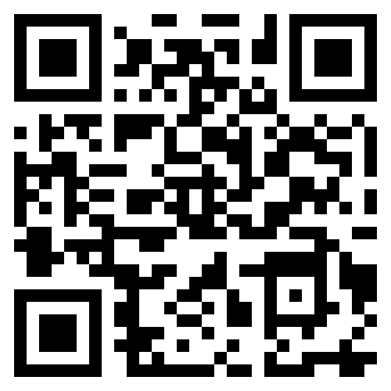
Thank you!
Questions & discussion
Try the live demo
doc-protect.vercel.app

